Slide 1




City of Agawam
Capital Improvement Program
Fiscal Year 2025 to Fiscal Year 2029

Slide 2
Table of Contents
Recurring
Capital
Needs
01
Existing
Approved
projects
02
New
projects
03

Slide 3
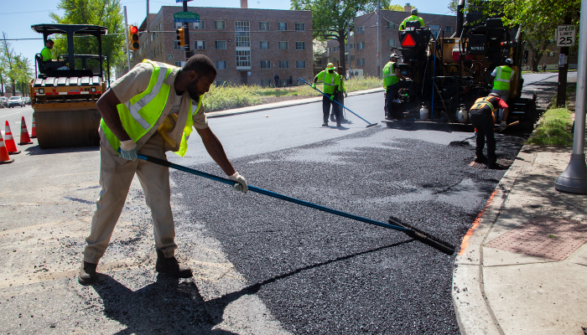
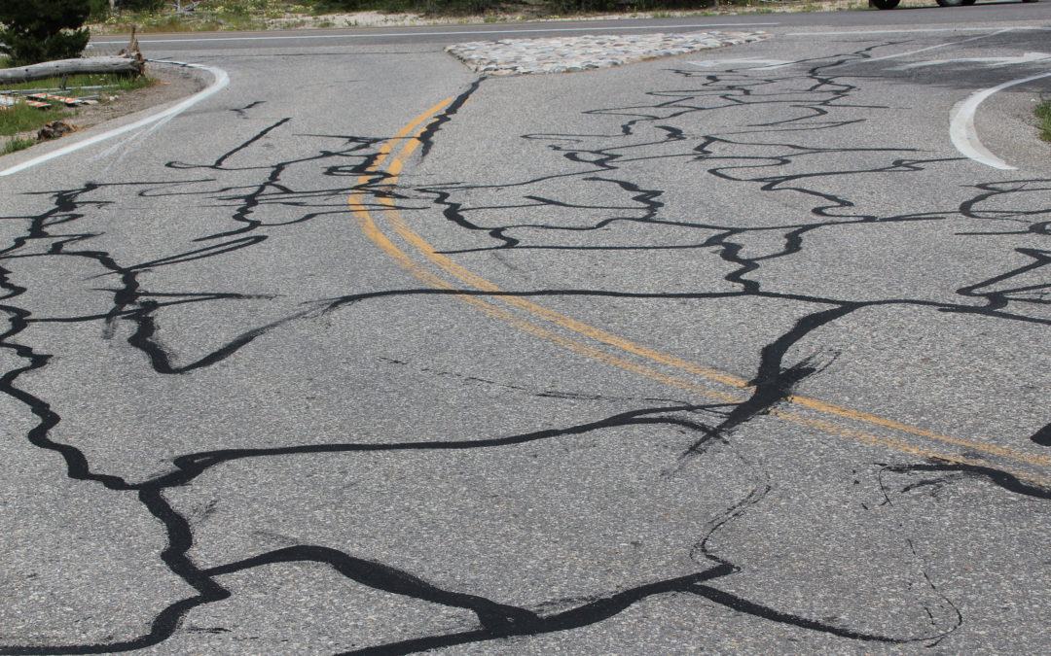
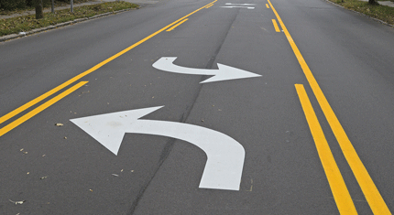
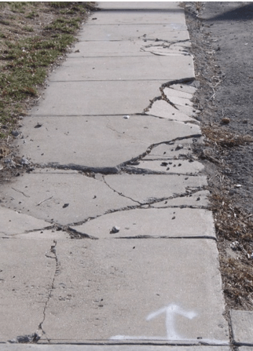

Recurring Capital Needs – funded by Annual Appropriation
Street and Infrastructure Improvement Program
Paving Streets
Crack Sealing
Pavement Marking
Sidewalk Rehabilitation
Traffic Light Improvements

Slide 4
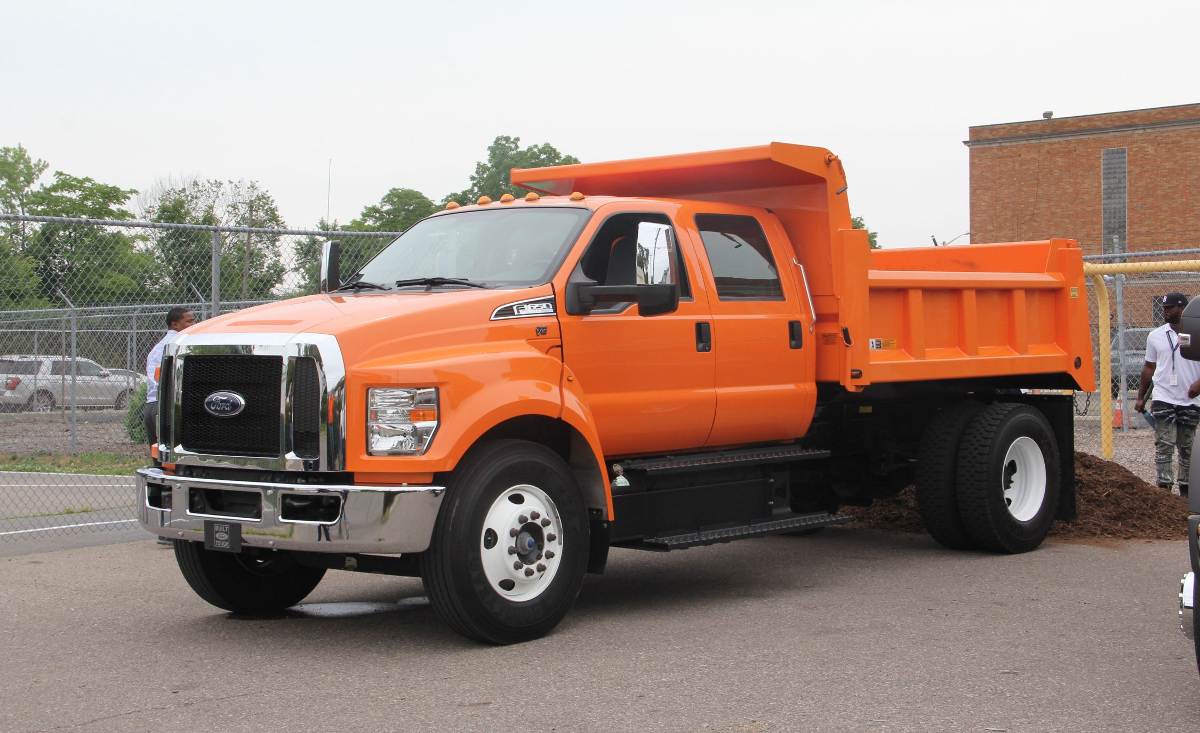
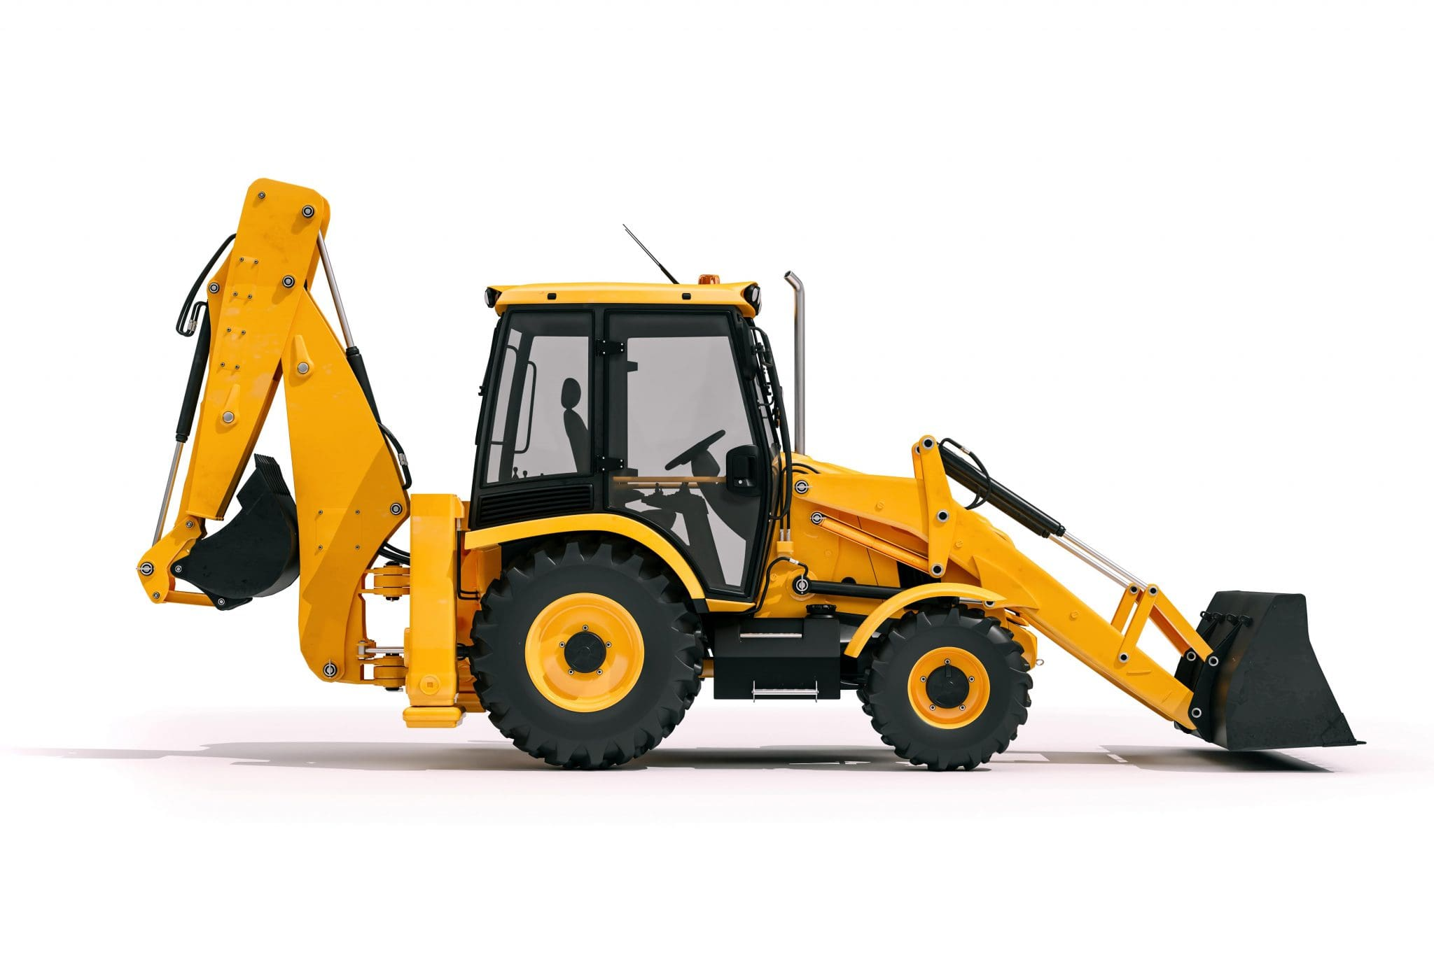
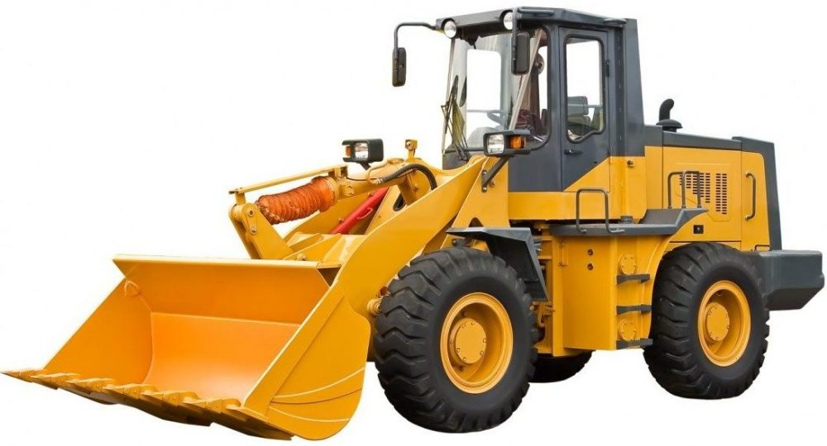
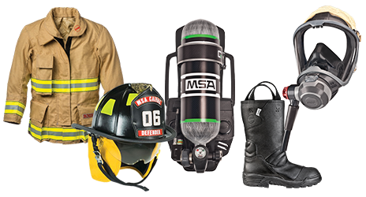
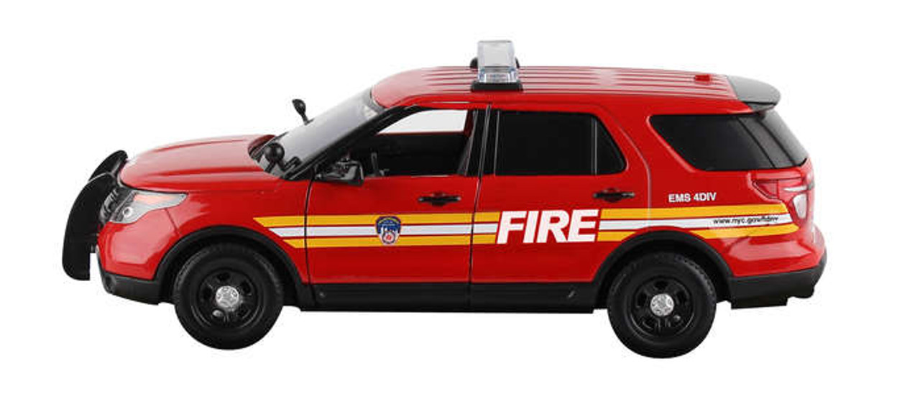
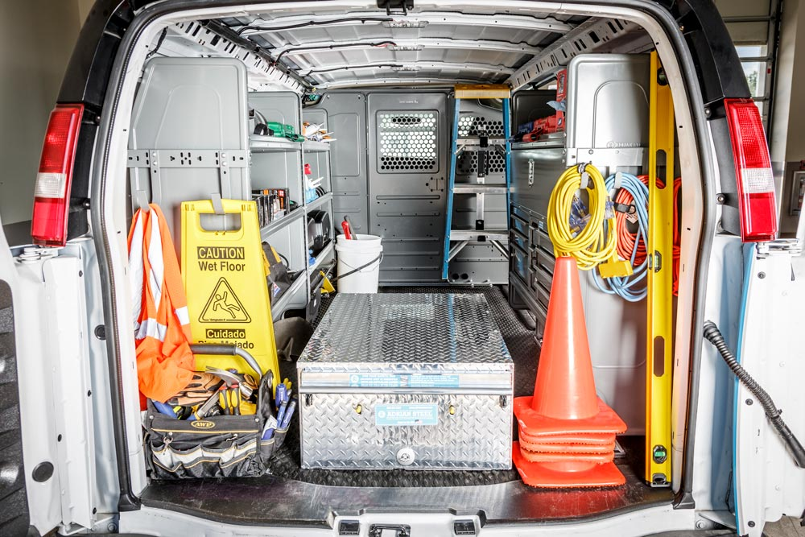
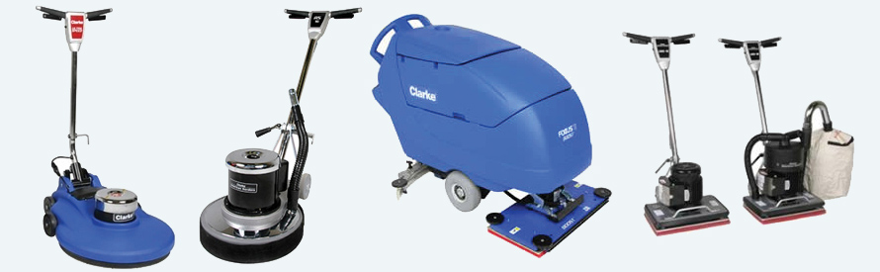
DPW Equipment
Fire Department Equipment
Building Maintenance Equipment

Slide 5
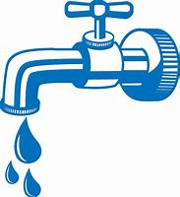

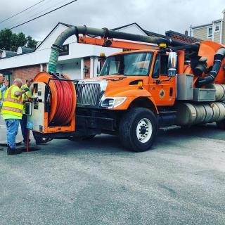
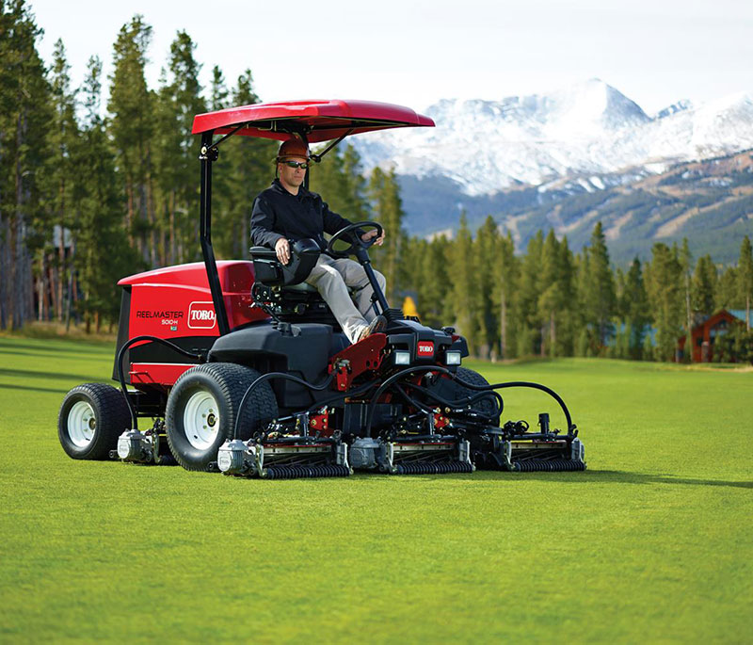
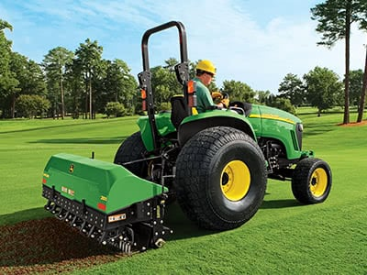
Water Equipment & Project Design
Wastewater Equipment & Project Design
Municipal Golf Equipment

Slide 6
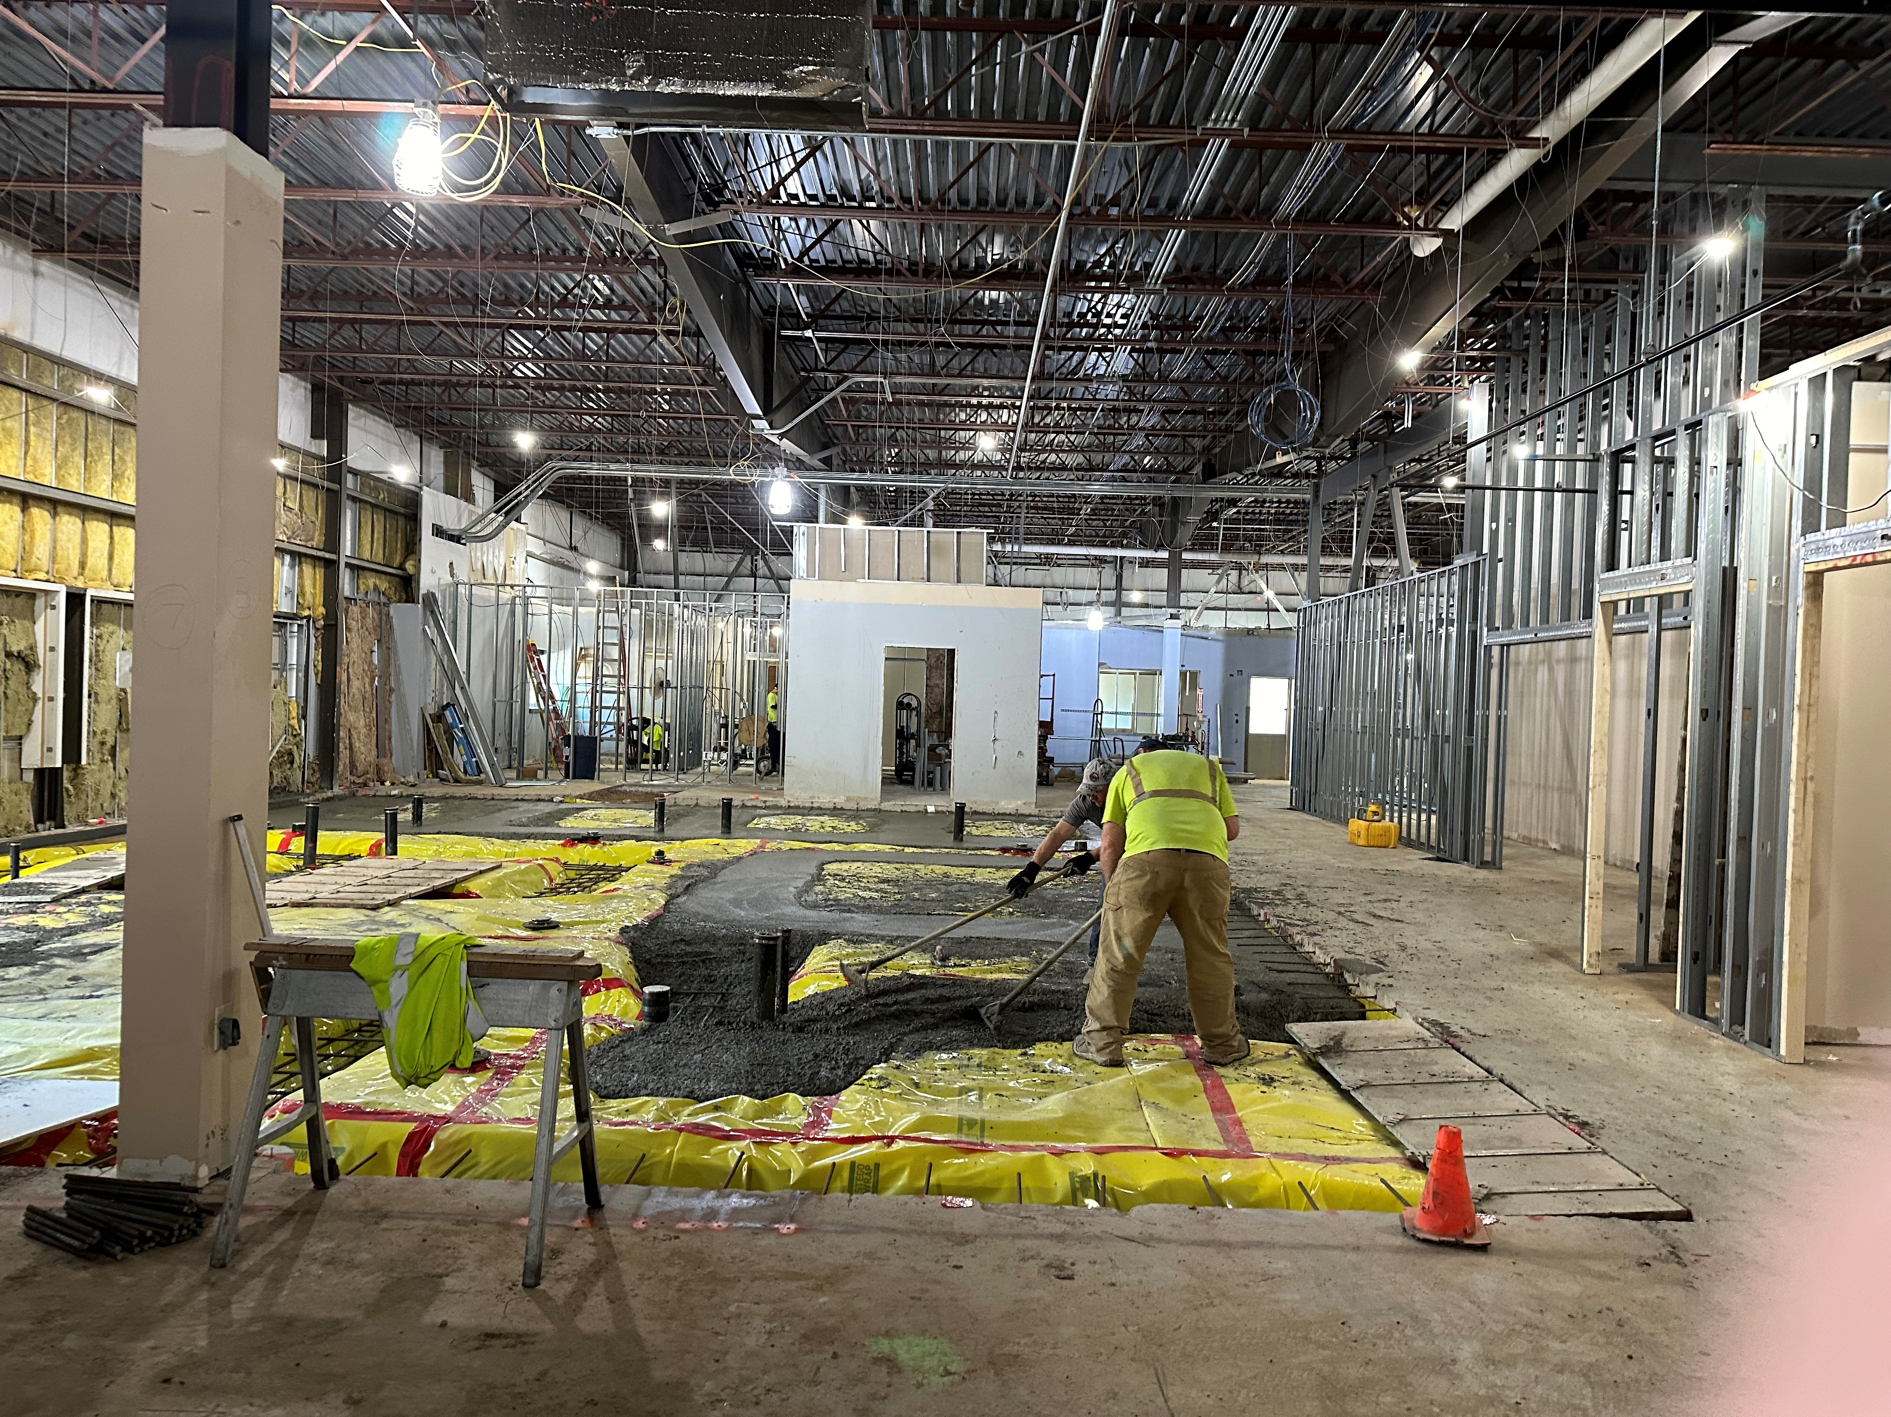
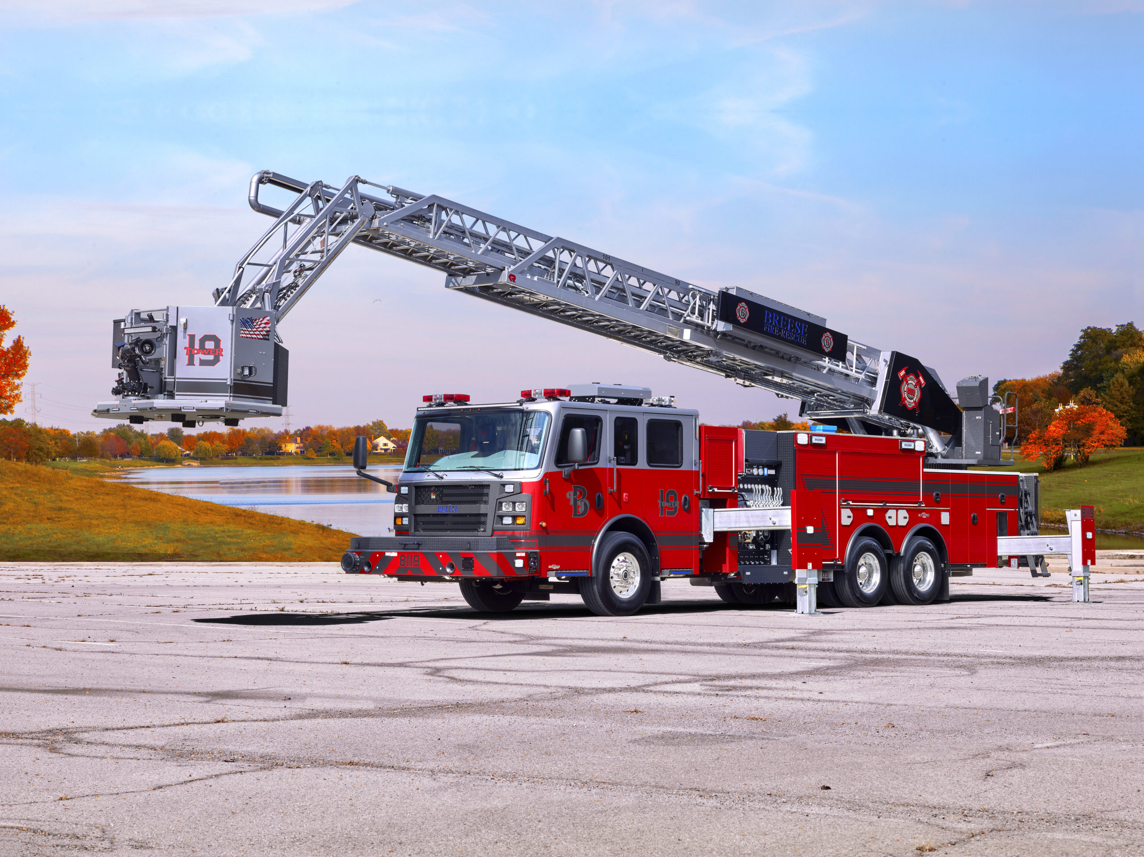
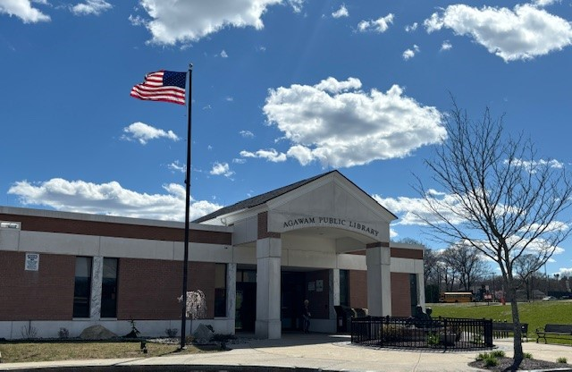
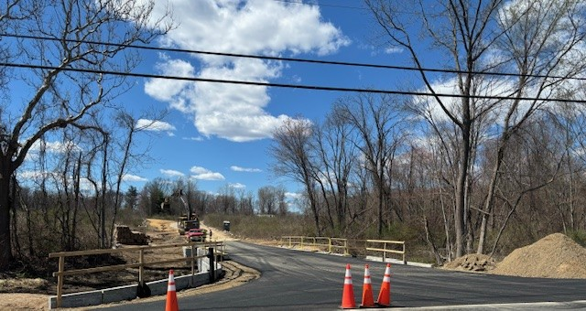
Existing Approved Projects
Aerial Platform Truck
Agawam Police Headquarters
Library Roof
Still Brook Park

Slide 7
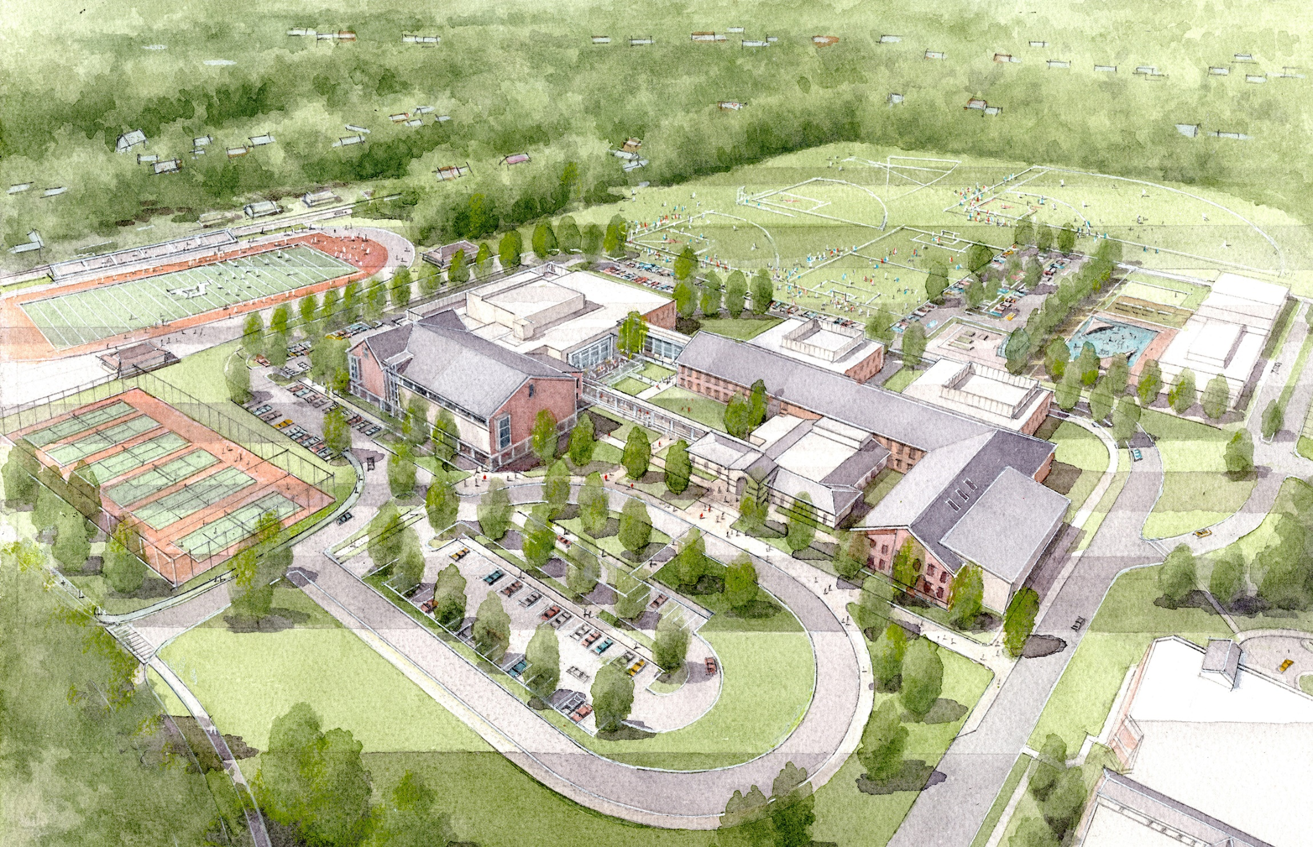
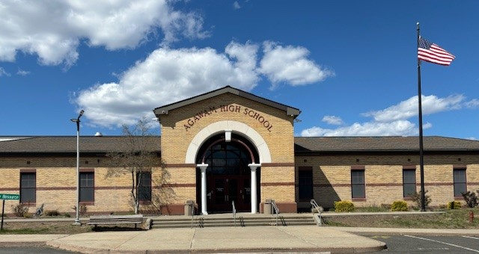
Agawam High School
Project
subject to voter approval
at June 11, 2024
Special Election

Slide 8
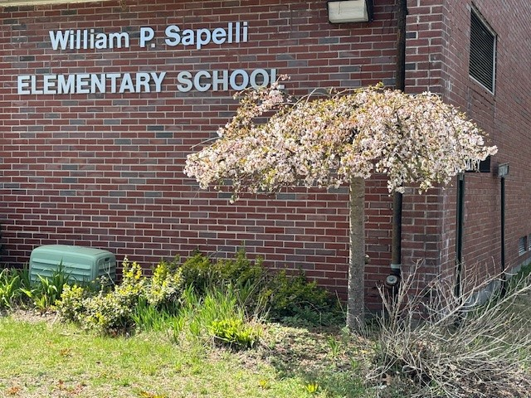
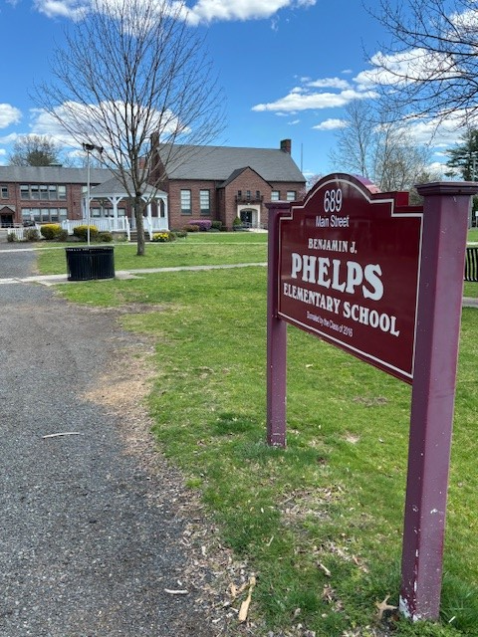
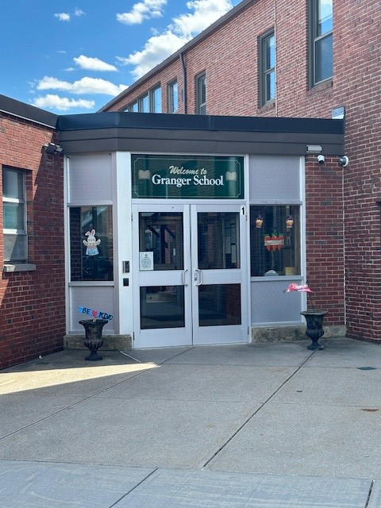
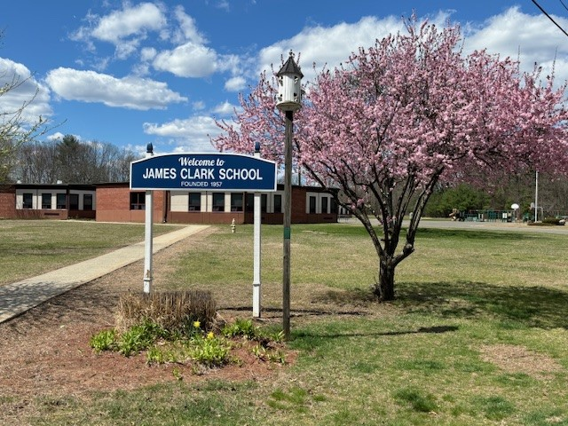
New Projects
Roofs on all 4 Elementary Schools

Slide 9
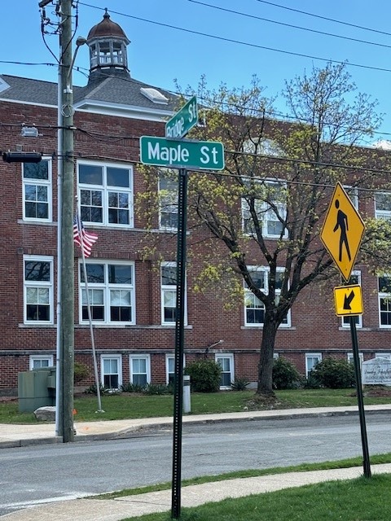
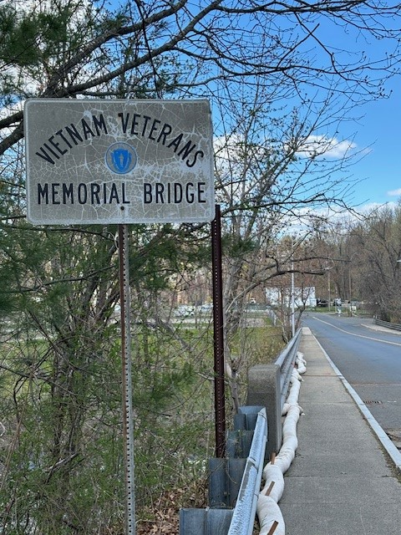
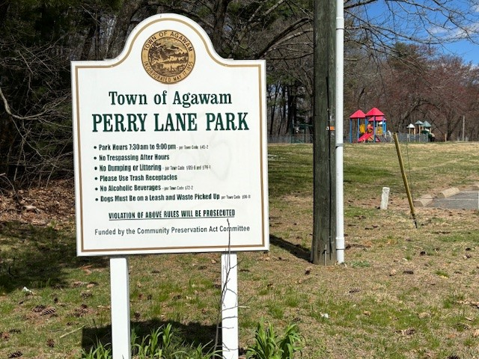
Feasibility Study
Recreation Center
Perry Lane Park
Maple Street Safe Routes
to School Project
Vietnam Veterans
Memorial Bridge

Slide 10
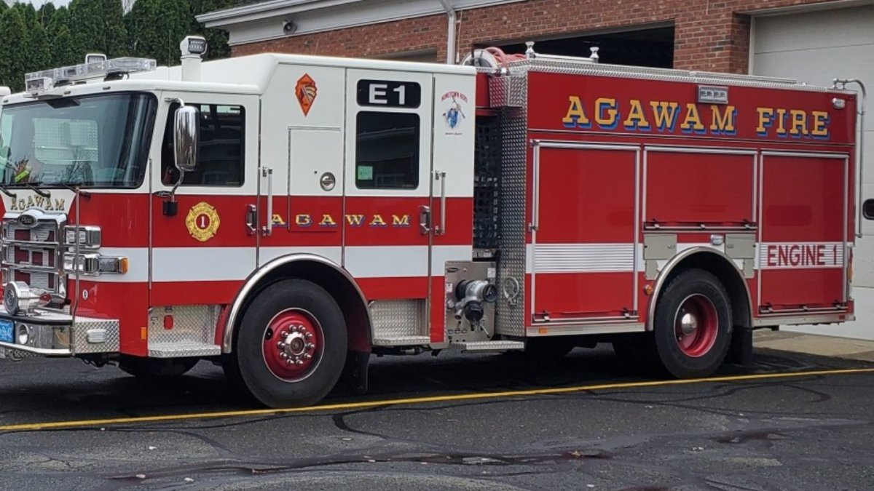
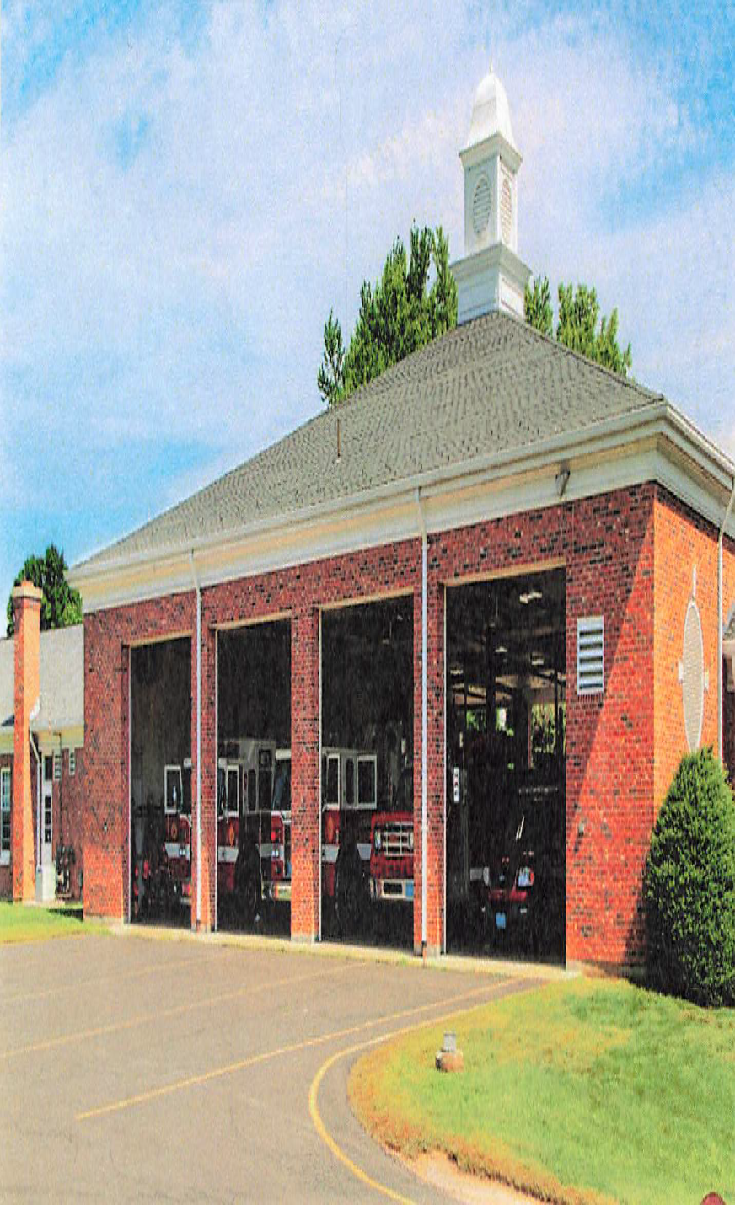
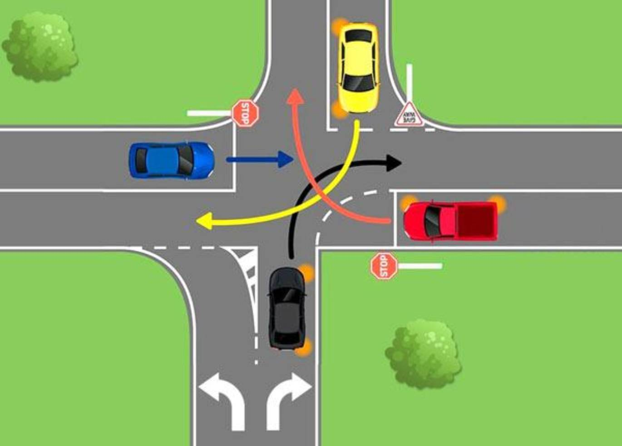
Two New Fire Engines
Suffield/Cooper
Rowley Street
Intersection
Fire Headquarters Roof

Slide 11
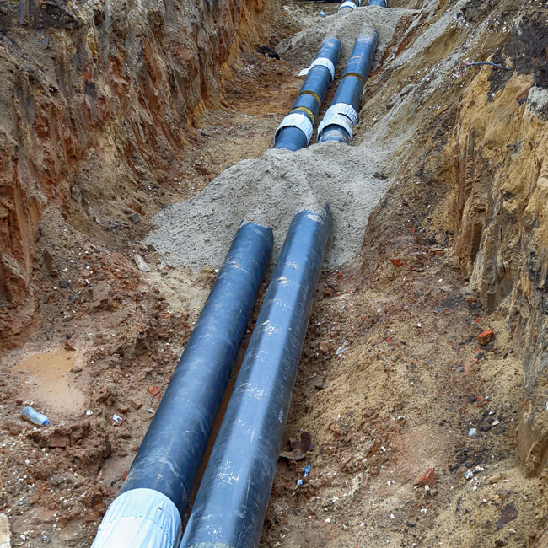
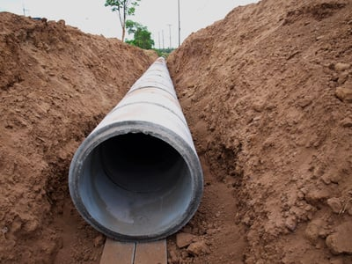
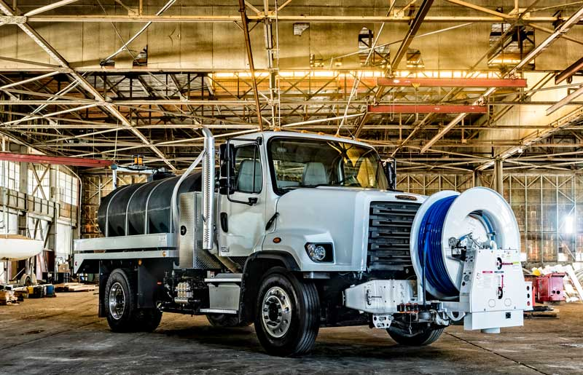
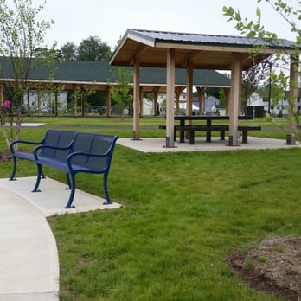
Wastewater Jetter/Vac Truck
New Sewer Line
Main Street
New Water Lines
Main Street
Suffield Street
Silver/Perry/Mill Street
School Street Pump Station Odor Control

Slide 12
Annual Appropriations
General Fund and Self Sustaining Departments
 | FY2025 | FY2026 | FY2027 | FY2028 | FY2029
GENERAL FUND APPROPRIATIONS | $2,215,000 | $2,688,800 | $2,330,000 | $2,483,000 | $2,619,435
WATER FUND APPROPRIATIONS | $415,174 | $227,174 | $197,174 | $297,174 | $447,174
WASTEWATER APPROPRIATIONS | $555,124 | $47,174 | $47,174 | $47,174 | $117,174
GOLF FUND APPROPRIATIONS | $25,000 | $25,000 | $25,000 | $25,000 | $25,000
TOTAL ANNUAL APPROPRIATIONS | $3,210,298 | $2,988,148 | $2,599,348 | $2,852,348 | $3,208,783

Slide 13
Existing General Fund Bond Costs
PROJECT | FY2025 | FY2026 | FY2027 | FY2028 | FY2029
DPW Facility Alterations | $63,504 | $61,152
Stormwater Project (CW-03-15) | $14,528
Senior Center | $392,255 | $377,295 | $357,361 | $342,454
Stormwater Project (CW-03-15A) | $6,538
Building Maintenance Extension | $5,975 | $5,850 | $5,725 | $5,600 | $5,450
Modular Classrooms | $86,400 | $83,200
Middle School Roof | $23,760 | $22,880
Middle & Jr High Repairs | $6,480 | $6,240
Athletic Facilities | $590,670 | $580,570 | $570,470 | $560,370 | $545,270
Middle School Boiler | $41,300 | $39,550 | $37,800 | $36,400
DPW Façade Repair | $18,880 | $18,080 | $17,280 | $16,640
Middle School Sewer/Stormwater | $134,750 | $129,500 | $124,250 | $114,000 | $109,000
Jr High Boiler | $38,250 | $36,750 | $35,250 | $33,750 | $27,250
LED Streetlights | $154,600 | $148,600 | $142,600 | $136,600 | $130,600
Existing General Fund Bonds | $1,577,890 | $1,509,667 | $1,290,736 | $1,245,814 | $817,570

Slide 15
General Fund Existing & New Bond Costs
 | FY2025 | FY2026 | FY2027 | FY2028 | FY2029
Existing General Fund Bonds | $1,577,890 | $1,509,667 | $1,290,736 | $1,245,814 | $817,570
Police HQ/Still Brook Park/Library |  | $1,702,879 | $1,663,759 | $1,624,638 | $1,585,518
Reed Street Outfall Project |  | $167,713 | $161,834 | $155,956 | $150,077
Suffield/Cooper/Rowley Streets |  |  | $245,625 | $239,250 | $232,875
Fire Engines |  |  |  | $299,250 | $290,325
Agawam High School Project |  |  |  |  | $10,010,000
Projected New Bonds | $0 | $1,870,592 | $2,071,218 | $2,319,094 | $12,268,795
Total Existing and New Bond Costs | $1,577,890 | $3,380,259 | $3,361,954 | $3,564,908 | $13,086,365

Slide 17
Self Sustaining Departments – Existing and New Bond Costs
 | FY2025 | FY2026 | FY2027 | FY2028 | FY2029
EXISTING WATER PROJECTS | $462,888 | $443,124 | $387,660 | $378,180 | $356,700
PROPOSED WATER PROJECTS
Main Street Water Main |  |  | $245,079 | $238,718 | $232,358
Suffield Street Water Main |  |  |  | $196,500 | $191,400
Silver/Perry/Mill Street Water Main |  |  |  |  | $163,750
TOTAL WATER BOND COSTS | $462,888 | $443,124 | $632,739 | $813,398 | $944,208
EXISTING WASTEWATER PROJECTS | $310,689 | $303,200 | $246,611 | $241,506 | $198,676
PROPOSED WASTEWATER PROJECTS
Main Street Sewer |  |  | $196,500 | $191,400 | $186,300
School Street Odor Control |  |  |  | $240,167 | $233,933
Recovery Station/Jetter |  |  |  |  | $142,500
TOTAL WASTEWATER BOND COSTS | $310,689 | $303,200 | $443,111 | $673,073 | $761,409

